Slide 1

Networking in the Cloud

Slide 2
SaaS, TCO, x86, ARM, Mac, Operating Systems

Slide 3
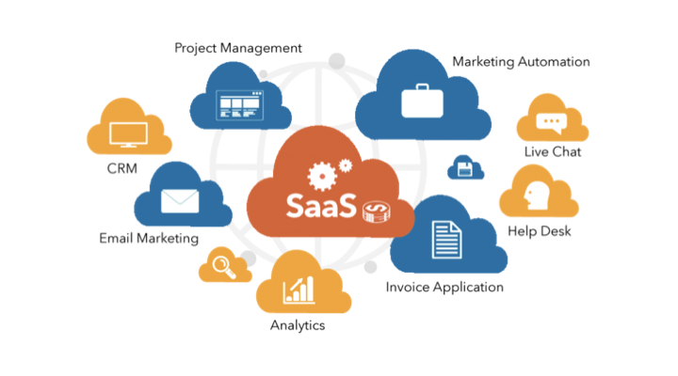
What is SaaS?
SaaS stands for Software as a Service.
It is a cloud computing model where software applications are provided to users over the internet. Users access the software through a web browser, eliminating the need for installation and maintenance on their local machines.

Slide 4
How Does SaaS Work?
SaaS providers host and manage the software applications on their servers. Users access the applications through a client interface, usually a web browser. The provider takes care of software updates, security, and infrastructure management, allowing users to focus on using the software rather than maintaining it.

Slide 5
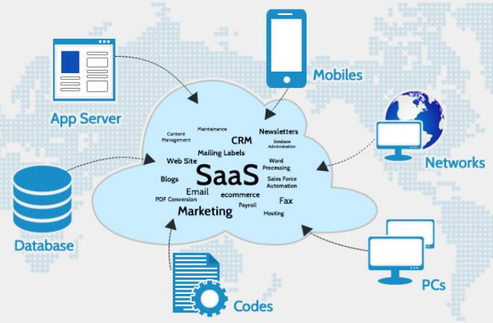

Slide 6
Benefits of SaaS
Cost Savings: SaaS eliminates the need for upfront hardware and software investments, reducing costs for businesses.
Scalability: SaaS allows users to easily scale up or down based on their requirements, paying only for the resources they use.
Accessibility: Users can access SaaS applications from any device with an internet connection, enabling remote work and collaboration.
Easy Updates: SaaS providers handle software updates and patches, ensuring users always have access to the latest features and improvements.

Slide 7
Advantages for Businesses
Rapid Deployment: SaaS applications can be quickly deployed, reducing time-to-market for businesses.
Lower Maintenance: With SaaS, businesses don't need to worry about software maintenance, updates, or infrastructure management.
Enhanced Collaboration: SaaS applications often include collaboration features, enabling teams to work together seamlessly.
Improved Security: SaaS providers implement robust security measures to protect user data, often surpassing what individual businesses can achieve.

Slide 8
Examples of SaaS Applications
Customer Relationship Management (CRM) systems like Salesforce.
Project Management tools such as Asana and Trello.
Communication and Collaboration platforms like Slack and Google Workspace.
Accounting Software such as QuickBooks Online and Xero.

Slide 9
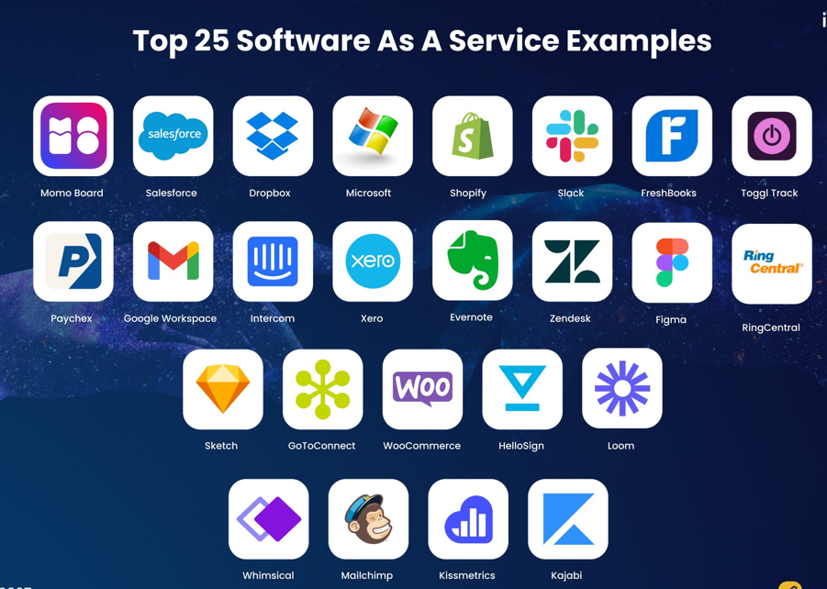

Slide 10
SaaS vs. Traditional Software
SaaS: Pay-as-you-go pricing, no upfront costs, automatic updates, scalable, accessible from anywhere.
Traditional Software: Upfront license fees, installation required, manual updates, limited scalability, tied to specific devices.

Slide 11
SaaS Adoption Considerations
Data Security: Assess the security measures implemented by the SaaS provider to protect your sensitive data.
Service Level Agreements (SLAs): Review the SLAs to ensure the availability and performance of the SaaS application meet your business needs.
Integration Capabilities: Check if the SaaS application can integrate with your existing systems and workflows.
Vendor Reputation: Research the vendor's reputation, customer reviews, and track record before committing to a SaaS solution.

Slide 12
SaaS Maturity Model
The SaaS Maturity Model is a framework that helps organizations assess and enhance their capabilities in adopting and leveraging Software as a Service (SaaS). It provides a structured approach to understand the journey from initial adoption to full utilization and optimization of SaaS solutions. Let's explore the different stages of the SaaS Maturity Model.

Slide 13
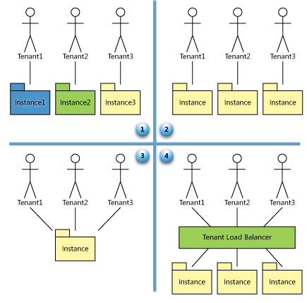

Slide 14
SaaS Maturity Model
Stage 1: Ad Hoc
At the initial stage, organizations have limited awareness and experience with SaaS. Adoption is ad hoc, with sporadic usage of SaaS applications. There is a lack of standardized processes and governance. The focus is primarily on solving immediate challenges rather than long-term strategy.

Slide 15
SaaS Maturity Model
Stage 2: Defined
In the defined stage, organizations start formalizing their SaaS adoption. There is a clearer understanding of business requirements and alignment with SaaS solutions. Defined processes and governance frameworks are established, ensuring better control and security. However, the usage of SaaS is still limited to specific departments or functions.

Slide 16
SaaS Maturity Model
Stage 3: Managed
At the managed stage, organizations have a comprehensive strategy for SaaS adoption. SaaS applications are managed across the organization with standardized processes and controls. Integration with other systems is prioritized, enabling data flow and collaboration. Cost optimization and vendor management strategies are implemented.

Slide 17
SaaS Maturity Model
Stage 4: Optimized
In the optimized stage, organizations have fully embraced SaaS and maximize its potential. SaaS solutions are strategically aligned with business goals. Continuous improvement and innovation are emphasized, leveraging analytics and insights to drive optimization. Scalability, security, and performance are key considerations.

Slide 18
Key Benefits of the SaaS Maturity Model
Clear Roadmap: The model provides a roadmap for organizations to progress from initial adoption to optimized utilization of SaaS, ensuring a strategic approach.
Governance and Control: It helps establish standardized processes and governance frameworks, enabling better control and security.

Slide 19
Key Benefits of the SaaS Maturity Model
Integration and Collaboration: Organizations can focus on integrating SaaS applications with other systems, fostering data flow and collaboration.
Cost Optimization: The model facilitates cost optimization strategies by evaluating SaaS investments, avoiding redundant applications, and optimizing vendor management.
Innovation and Optimization: It encourages organizations to continuously improve and innovate, leveraging insights to drive optimization and gain a competitive edge.

Slide 20
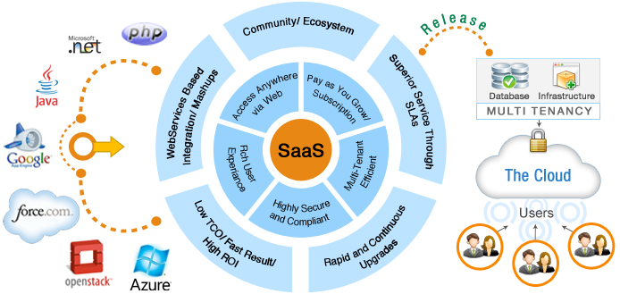
Consideration for SAAS Application development

Slide 21
Important factors for good design of SAAS model
A well-designed SaaS application can be distinguished from a poorly designed one based on three key factors: scalability, configurability, and multi-tenancy efficiency.

Slide 22
Important factors for good design of SAAS model
Scalability: A well-designed SaaS application focuses on maximizing concurrency and efficiently utilizing resources. This involves optimizing factors such as locking duration, statelessness, utilizing shared resources like threads and network connections, caching reference data, and partitioning large databases.
Configurability: In a well-designed SaaS application, customization and configuration are achieved without the need for code changes. Each customer should be able to configure the application to meet their specific needs, without affecting other customers. The application should provide simple and easy-to-use tools for customers to configure the appearance and behavior of the application for their users, without incurring additional development or operational costs.

Slide 23
Important factors for good design of SAAS model
Multi-tenancy: A well-designed SaaS application embraces a multi-tenant architecture, allowing multiple companies to use the same application instance simultaneously while ensuring transparency. The architecture should enable efficient sharing of resources across tenants, ensuring optimal utilization and performance.

Slide 24
SaaS Implementation Challenges
Data Migration: Transferring data from existing systems to a SaaS application can be complex and time-consuming.
Internet Connectivity: SaaS applications require a stable internet connection for uninterrupted access.
Customization Limitations: SaaS applications may have limited customization options compared to on-premises software.
Vendor Lock-in: Evaluate the contract terms and exit strategy in case you decide to switch or terminate the SaaS service.

Slide 25
Future Trends in SaaS
Industry-Specific Solutions: SaaS offerings tailored to specific industries will continue to grow.
Artificial Intelligence (AI) Integration: SaaS applications will increasingly leverage AI capabilities for enhanced functionality and user experience.
Internet of Things (IoT) Integration: SaaS solutions will integrate with IoT devices to enable data-driven insights and automation.
Hybrid SaaS Models: Hybrid models combining SaaS and on-premises solutions will emerge to meet diverse business requirements.

Slide 26
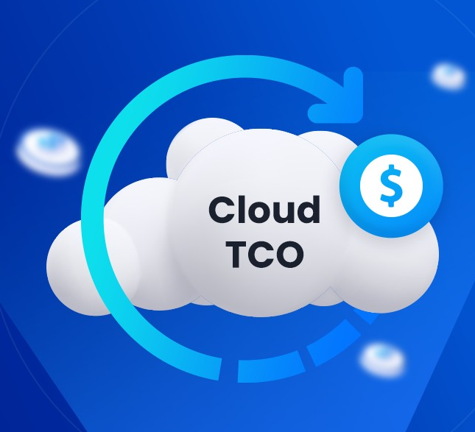
What is cloud TCO?
Cloud TCO is the cumulative expenses associated with adopting, operating, and provisioning cloud services. The complexity of your operations dictates your specific cloud TCO. Initially, estimation focuses on migrating from on-premise to the cloud, then expands to factors like rack rate, compute, data storage, networking, and data transfer costs.
Cloud TCO provides insight into the expenses of hosting, running, integrating, and managing workloads in the cloud.

Slide 27
What is a TCO model?
A cloud TCO model typically comprises two primary cost categories: upfront and ongoing expenses. Upfront costs include the implementation phase of a cloud computing environment, covering planning, assessment, initial fees from Cloud Service Providers (CSPs), data migration, application adaptation, consultant fees, training, and security measures.
Ongoing operational costs include monthly or annual subscription fees charged by CSPs, often based on usage volume and type of services utilized. For instance, data storage rates differ from data transfer or processing fees. Additional charges may apply for upgraded services like advanced analytics or machine learning capabilities. Ongoing training expenses for skill enhancement and maintenance fees, primarily handled by CSPs, contribute to ongoing operational costs.

Slide 28
Factors that affect cloud TCO
Understanding the diverse factors affecting TCO is essential for informed decision-making in cloud adoption. Numerous factors contribute to the overall cost structure, from business characteristics to technical considerations. Here are some key factors:
Type of business: Highly regulated industries (finance, healthcare) or those with bursty workloads (media, e-commerce) may require specialized cloud features that impact costs.
Training expenses: Upskilling your IT team on cloud technologies adds to the upfront investment but ensures efficient cloud management in the long run.

Slide 29
Factors that affect cloud TCO
Application complexity: Migrating complex, on-premises applications to the cloud might necessitate code modifications, potentially increasing migration costs.
Regulatory compliance: Compliance with industry regulations, particularly around data privacy, may require additional security controls and audits, which can impact your cloud TCO.
Infrastructure attributes: The underlying infrastructure of your chosen cloud provider (data center location, security protocols) can influence cloud service costs.
Risk management: Implementing robust security measures to protect your cloud environment adds to the initial investment but safeguards your data and minimizes potential security breaches.
Operational processes: The business processes migrated to the cloud, such as email and CRM systems, along with supplementary services like cloud automation and disaster recovery provided by your CSP, will impact resource allocation and, consequently, subscription fees for cloud services

Slide 30
Factors that affect cloud TCO
Application complexity: Migrating complex, on-premises applications to the cloud might necessitate code modifications, potentially increasing migration costs.
Regulatory compliance: Compliance with industry regulations, particularly around data privacy, may require additional security controls and audits, which can impact your cloud TCO.
Infrastructure attributes: The underlying infrastructure of your chosen cloud provider (data center location, security protocols) can influence cloud service costs.
Risk management: Implementing robust security measures to protect your cloud environment adds to the initial investment but safeguards your data and minimizes potential security breaches.
Operational processes: The business processes migrated to the cloud, such as email and CRM systems, along with supplementary services like cloud automation and disaster recovery provided by your CSP, will impact resource allocation and, consequently, subscription fees for cloud services

Slide 31
Understand key cost factors
To facilitate an informed comparison of cloud TCO, calculate the total cost of your existing infrastructure. Infrastructure costs typically encompass tangible expenses that are easily quantifiable, though specifics may vary based on your cloud infrastructure.
Infrastructure and operational expenses: Compare hardware, networking, and operating expenditures expenses of on-premise solutions with subscription fees for cloud services.
Software licensing analysis: Analyze differences in software licensing costs between on-premise solutions and cloud-based subscription models.

Slide 32
Direct costs
Subscription charges: Base costs of cloud services, usually calculated on a monthly or hourly basis, depending on usage.
Compute instances fees: Charges for virtual machine instances based on their size, configuration, and usage.
Networking charges: Fees related to data transfer within the cloud environment and to and from the internet.
Backup and disaster recovery expenses: Costs associated with backup storage and disaster recovery solutions.

Slide 33
Hidden expenses
Data storage charges: Consider potential charges for storing large data volumes by cloud providers.
Data retrieval fees: Note additional charges for retrieving data from certain cloud storage services.
Network traffic expenses: Be aware of egress costs and network traffic costs associated with interacting with cloud services, especially across different regions.
Vendor lock-in implications: Recognize potential customer lock-in cost implications of switching cloud providers in the future.

Slide 34
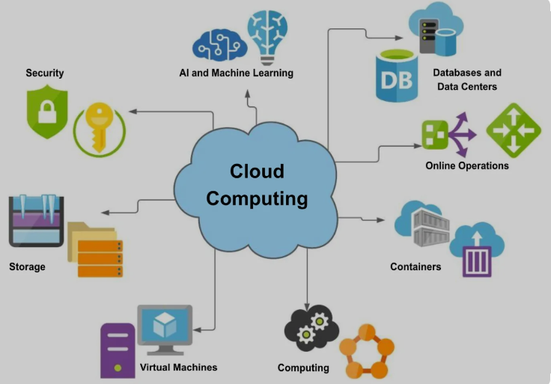
Virtualization in Cloud Computing and Types
Virtualization is used to create a virtual version of an underlying service With the help of Virtualization, multiple operating systems and applications can run on the same machine and its same hardware at the same time, increasing the utilization and flexibility of hardware. It was initially developed during the mainframe era.
It is one of the main cost-effective, hardware-reducing, and energy-saving techniques used by cloud providers. Virtualization allows sharing of a single physical instance of a resource or an application among multiple customers and organizations at one time. It does this by assigning a logical name to physical storage and providing a pointer to that physical resource on demand.

Slide 35
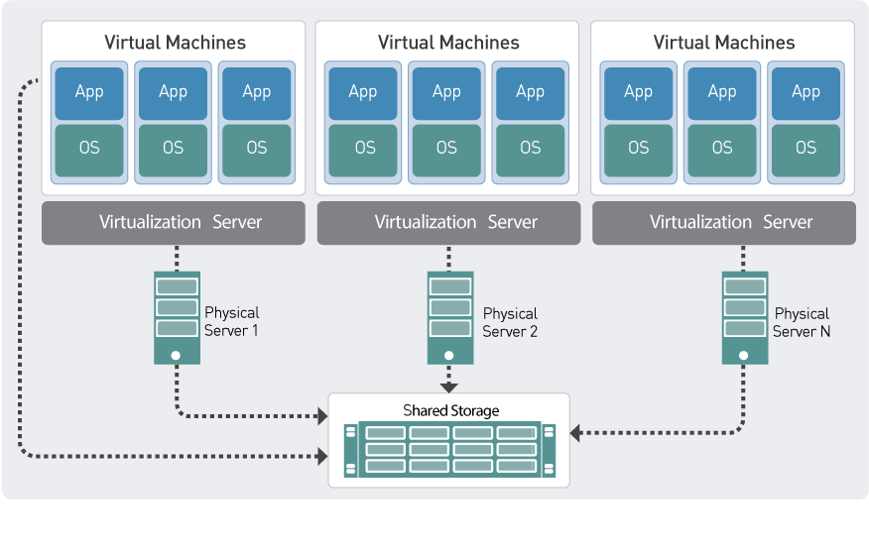

Slide 36
Virtualization in Cloud Computing and Types
The term virtualization is often synonymous with hardware virtualization, which plays a fundamental role in efficiently delivering Infrastructure-as-a-Service (IaaS) solutions for cloud computing. Moreover, virtualization technologies provide a virtual environment for not only executing applications but also for storage, memory, and networking
Host Machine: The machine on which the virtual machine is going to be built is known as Host Machine.
Guest Machine: The virtual machine is referred to as a Guest Machine.

Slide 37
Working of Virtualization in Cloud Computing
Virtualization has a prominent impact on Cloud Computing. In the case of cloud computing, users store data in the cloud, but with the help of Virtualization, users have the extra benefit of sharing the infrastructure.
Cloud Vendors take care of the required physical resources, but these cloud providers charge a huge amount for these services which impacts every user or organization. Virtualization helps Users or Organisations in maintaining those services which are required by a company through external (third-party) people, which helps in reducing costs to the company. This is the way through which Virtualization works in Cloud Computing.

Slide 38
Benefits of Virtualization
Here are some of the benefits of using Virtualization in Cloud Computing
More flexible and efficient allocation of resources.
Enhance development productivity.
It lowers the cost of IT infrastructure.
Remote access and rapid scalability.
High availability and disaster recovery.
Pay peruse of the IT infrastructure on demand.
Enables running multiple operating systems.

Slide 39
Drawback of Virtualization
High Initial Investment: Clouds have a very high initial investment, but it is also true that it will help in reducing the cost of companies.
Learning New Infrastructure: As the companies shifted from Servers to Cloud, it requires highly skilled staff who have skills to work with the cloud easily and for this, you have to hire new staff or provide training to current staff.
Risk of Data: Hosting data on third-party resources can lead to putting the data at risk, it has the chance of getting attacked by any hacker or cracker very easily.

Slide 40
Characteristics of Virtualization
Increased Security: The ability to control the execution of a guest program in a completely transparent manner opens new possibilities for delivering a secure, controlled execution environment. All the operations of the guest programs are generally performed against the virtual machine, which then translates and applies them to the host programs.
Managed Execution: In particular, sharing, aggregation, emulation, and isolation are the most relevant features.
Sharing: Virtualization allows the creation of a separate computing environment within the same host.
Aggregation: It is possible to share physical resources among several guests, but virtualization also allows aggregation, which is the opposite process.

Slide 41
Types of Virtualization
Application Virtualization: This lets you use an application on your local device while it’s actually hosted on a remote server. Your personal data and the app’s settings are stored on the server, but you can still run it locally via the internet. It’s useful if you need to work with multiple versions of the same software. Common examples include hosted or packaged apps.
Network Virtualization: This allows multiple virtual networks to run on the same physical network, each operating independently. You can quickly set up virtual switches, routers, firewalls, and VPNs, making network management more flexible and efficient.

Slide 42
Types of Virtualization
Desktop Virtualization: With desktop virtualization, your operating system is stored on a server and can be accessed from anywhere on any device. It’s great for users who need flexibility, as it simplifies software updates and provides portability.
Storage Virtualization: This combines storage from different servers into a single system, making it easier to manage. It ensures smooth performance and efficient operations even when the underlying hardware changes or fails.
Server Virtualization: This splits a physical server into multiple virtual servers, each functioning independently. It helps improve performance, cut costs and makes tasks like server migration and energy management easier.

Slide 43
Types of Virtualization
Data Virtualization: This brings data from different sources together in one place without needing to know where or how it’s stored. It creates a unified view of the data, which can be accessed remotely via cloud services. Companies like Oracle and IBM offer solutions for this.

Slide 44
Virtualization vs Containerization
Aspect | Virtualization | Containerization
Architecture | Full OS per VM | Shared host OS
Resource Usage | High | Low
Performance | Slightly slower due to overhead | Faster due to lightweight design
Scalability | Limited by heavier VMs | Highly scalable
Portability | Moderate | Very high
Use Case | Running multiple OS types | Rapid deployment of apps

Slide 45
Uses of Virtualization
Resource Optimization: Maximizes hardware utilization by running multiple virtual machines on a single server.
Cost Reduction: Reduces hardware and maintenance costs by consolidating servers.
Scalability: Enables quick scaling of resources based on demand.
Flexibility: Dynamically allocates resources to applications as needed.
Disaster Recovery: Simplifies backup and recovery by easily restoring virtual machines.
Multi-Tenancy: Supports multiple users on a single server securely and efficiently.
Testing Environments: Provides isolated virtual environments for development and testing.
Efficient Deployment: Speeds up application deployment with pre-configured virtual environments.
Security Isolation: Keeps applications secure by isolating them in separate virtual machines.
Energy Efficiency: Reduces power consumption by running fewer physical servers

Slide 46
Uses of Virtualization
Resource Optimization: Maximizes hardware utilization by running multiple virtual machines on a single server.
Cost Reduction: Reduces hardware and maintenance costs by consolidating servers.
Scalability: Enables quick scaling of resources based on demand.
Flexibility: Dynamically allocates resources to applications as needed.
Disaster Recovery: Simplifies backup and recovery by easily restoring virtual machines.
Multi-Tenancy: Supports multiple users on a single server securely and efficiently.
Testing Environments: Provides isolated virtual environments for development and testing.
Efficient Deployment: Speeds up application deployment with pre-configured virtual environments.
Security Isolation: Keeps applications secure by isolating them in separate virtual machines.
Energy Efficiency: Reduces power consumption by running fewer physical servers

Slide 47

Different types of architecture and platforms
Operating Systems
Operating systems provide the environment in which applications run. They manage hardware resources and provide services to software.
Linux
Linux is an open-source, Unix-like operating system kernel. It is highly customizable and available in many distributions (distros).
Examples:
Servers (e.g., web servers, database servers).
Embedded systems (e.g., routers, IoT devices).
Desktops (e.g., Ubuntu, Fedora).
Architectures Supported:
x86, x86_64, ARM, PowerPC, SPARC, etc.
Popular Distributions:
Ubuntu, Debian, CentOS, Red Hat Enterprise Linux (RHEL), Fedora.

Slide 48
Different types of architecture and platforms
Windows
Windows is a proprietary operating system developed by Microsoft. It is widely used in desktop and server environments.
Examples:
Desktops and laptops.
Enterprise servers (Windows Server).
Gaming.
Architectures Supported
x86, x86_64, ARM.
Versions:
Windows 10, Windows 11 (desktop).
Windows Server 2019, Windows Server 2022 (server).

Slide 49
Different types of architecture and platforms
macOS
macOS is a proprietary operating system developed by Apple. It is based on Unix and runs on Apple hardware.
Examples:
Creative professionals (e.g., video editing, graphic design).
General-purpose computing.
Architectures Supported:
Previously x86, now ARM (Apple Silicon: M1, M2).
Versions:
macOS Big Sur, Monterey, Ventura.

Slide 50
Different types of architecture and platforms
Unix
Unix is a family of multitasking, multiuser operating systems that were originally developed in the 1970s. Modern Unix-like systems include Linux and macOS.
Examples:
Servers.
Workstations.
Architectures Supported:
- x86, x86_64, ARM, SPARC, etc.
Examples:
Solaris, AIX, HP-UX.

Slide 51
Different types of architecture and platforms
Cloud Platforms
Cloud platforms provide infrastructure, platform, and software services over the internet. They allow businesses to scale resources dynamically without managing physical hardware.
Amazon Web Services (AWS)
AWS is a comprehensive cloud platform offering compute, storage, databases, machine learning, and more.
Architectures Supported:
x86 (EC2 instances).
ARM (AWS Graviton processors).
Services:
EC2 (Elastic Compute Cloud), S3 (Simple Storage Service), Lambda (serverless computing).

Slide 52
Different types of architecture and platforms
Microsoft Azure
Azure is Microsoft's cloud platform, offering similar services to AWS.
Architectures Supported:
x86, ARM.
Services:
Virtual Machines, Azure Functions (serverless), Azure SQL Database.
Google Cloud Platform (GCP)
GCP offers cloud computing services including compute, storage, machine learning, and big data analytics.
Architectures Supported:
x86, ARM.
Services:
Compute Engine, Kubernetes Engine, BigQuery.

Slide 53
Different types of architecture and platforms
IBM Cloud
IBM Cloud provides cloud services with a focus on enterprise solutions, AI, and hybrid cloud environments.
Architectures Supported:
x86, PowerPC.
Services:
- IBM Cloud Foundry, Kubernetes Service, Watson AI.

Slide 54
Different types of architecture and platforms
Deployment Models
Deployment models refer to how software is delivered and managed in an environment.
Client-Server Architecture
In client-server architecture, clients (e.g., web browsers, mobile apps) request services from a central server. The server manages resources and responds to client requests.
Use Cases:
Web applications.
Email services.
File sharing.
Platforms:
Linux, Windows, macOS can all serve as either clients or servers.

Slide 55
Different types of architecture and platforms
Peer-to-Peer (P2P) Architecture
In P2P architecture, each node (peer) acts as both a client and a server. There is no central server; peers share resources directly.
Use Cases:
File sharing (e.g., BitTorrent).
Decentralized applications (e.g., blockchain).
Platforms:
Any platform that supports networking (Linux, Windows, macOS).

Slide 56
Different types of architecture and platforms
Microservices Architecture
Microservices architecture decomposes an application into small, independent services that communicate via APIs. Each service can be developed, deployed, and scaled independently.
Use Cases:
Scalable web applications.
Cloud-native applications.
Platforms:
Cloud platforms (AWS, Azure, GCP) often host microservices.
Container orchestration tools like Kubernetes are commonly used.

Slide 57
Different types of architecture and platforms
Serverless Architecture
In serverless architecture, developers write code (functions) that runs in response to events, without managing the underlying infrastructure. The cloud provider manages the servers.
Use Cases:
Event-driven applications.
Real-time file processing.
Platforms:
AWS Lambda, Azure Functions, Google Cloud Functions.
Each architecture and platform has its own strengths and is suited for different use cases. For example, ARM is ideal for mobile and low-power devices, while x86 dominates the desktop and server markets. Cloud platforms like AWS and Azure offer flexible, scalable environments for deploying applications across various architectures.

Slide 58
Thank You !!!

